Slide 1
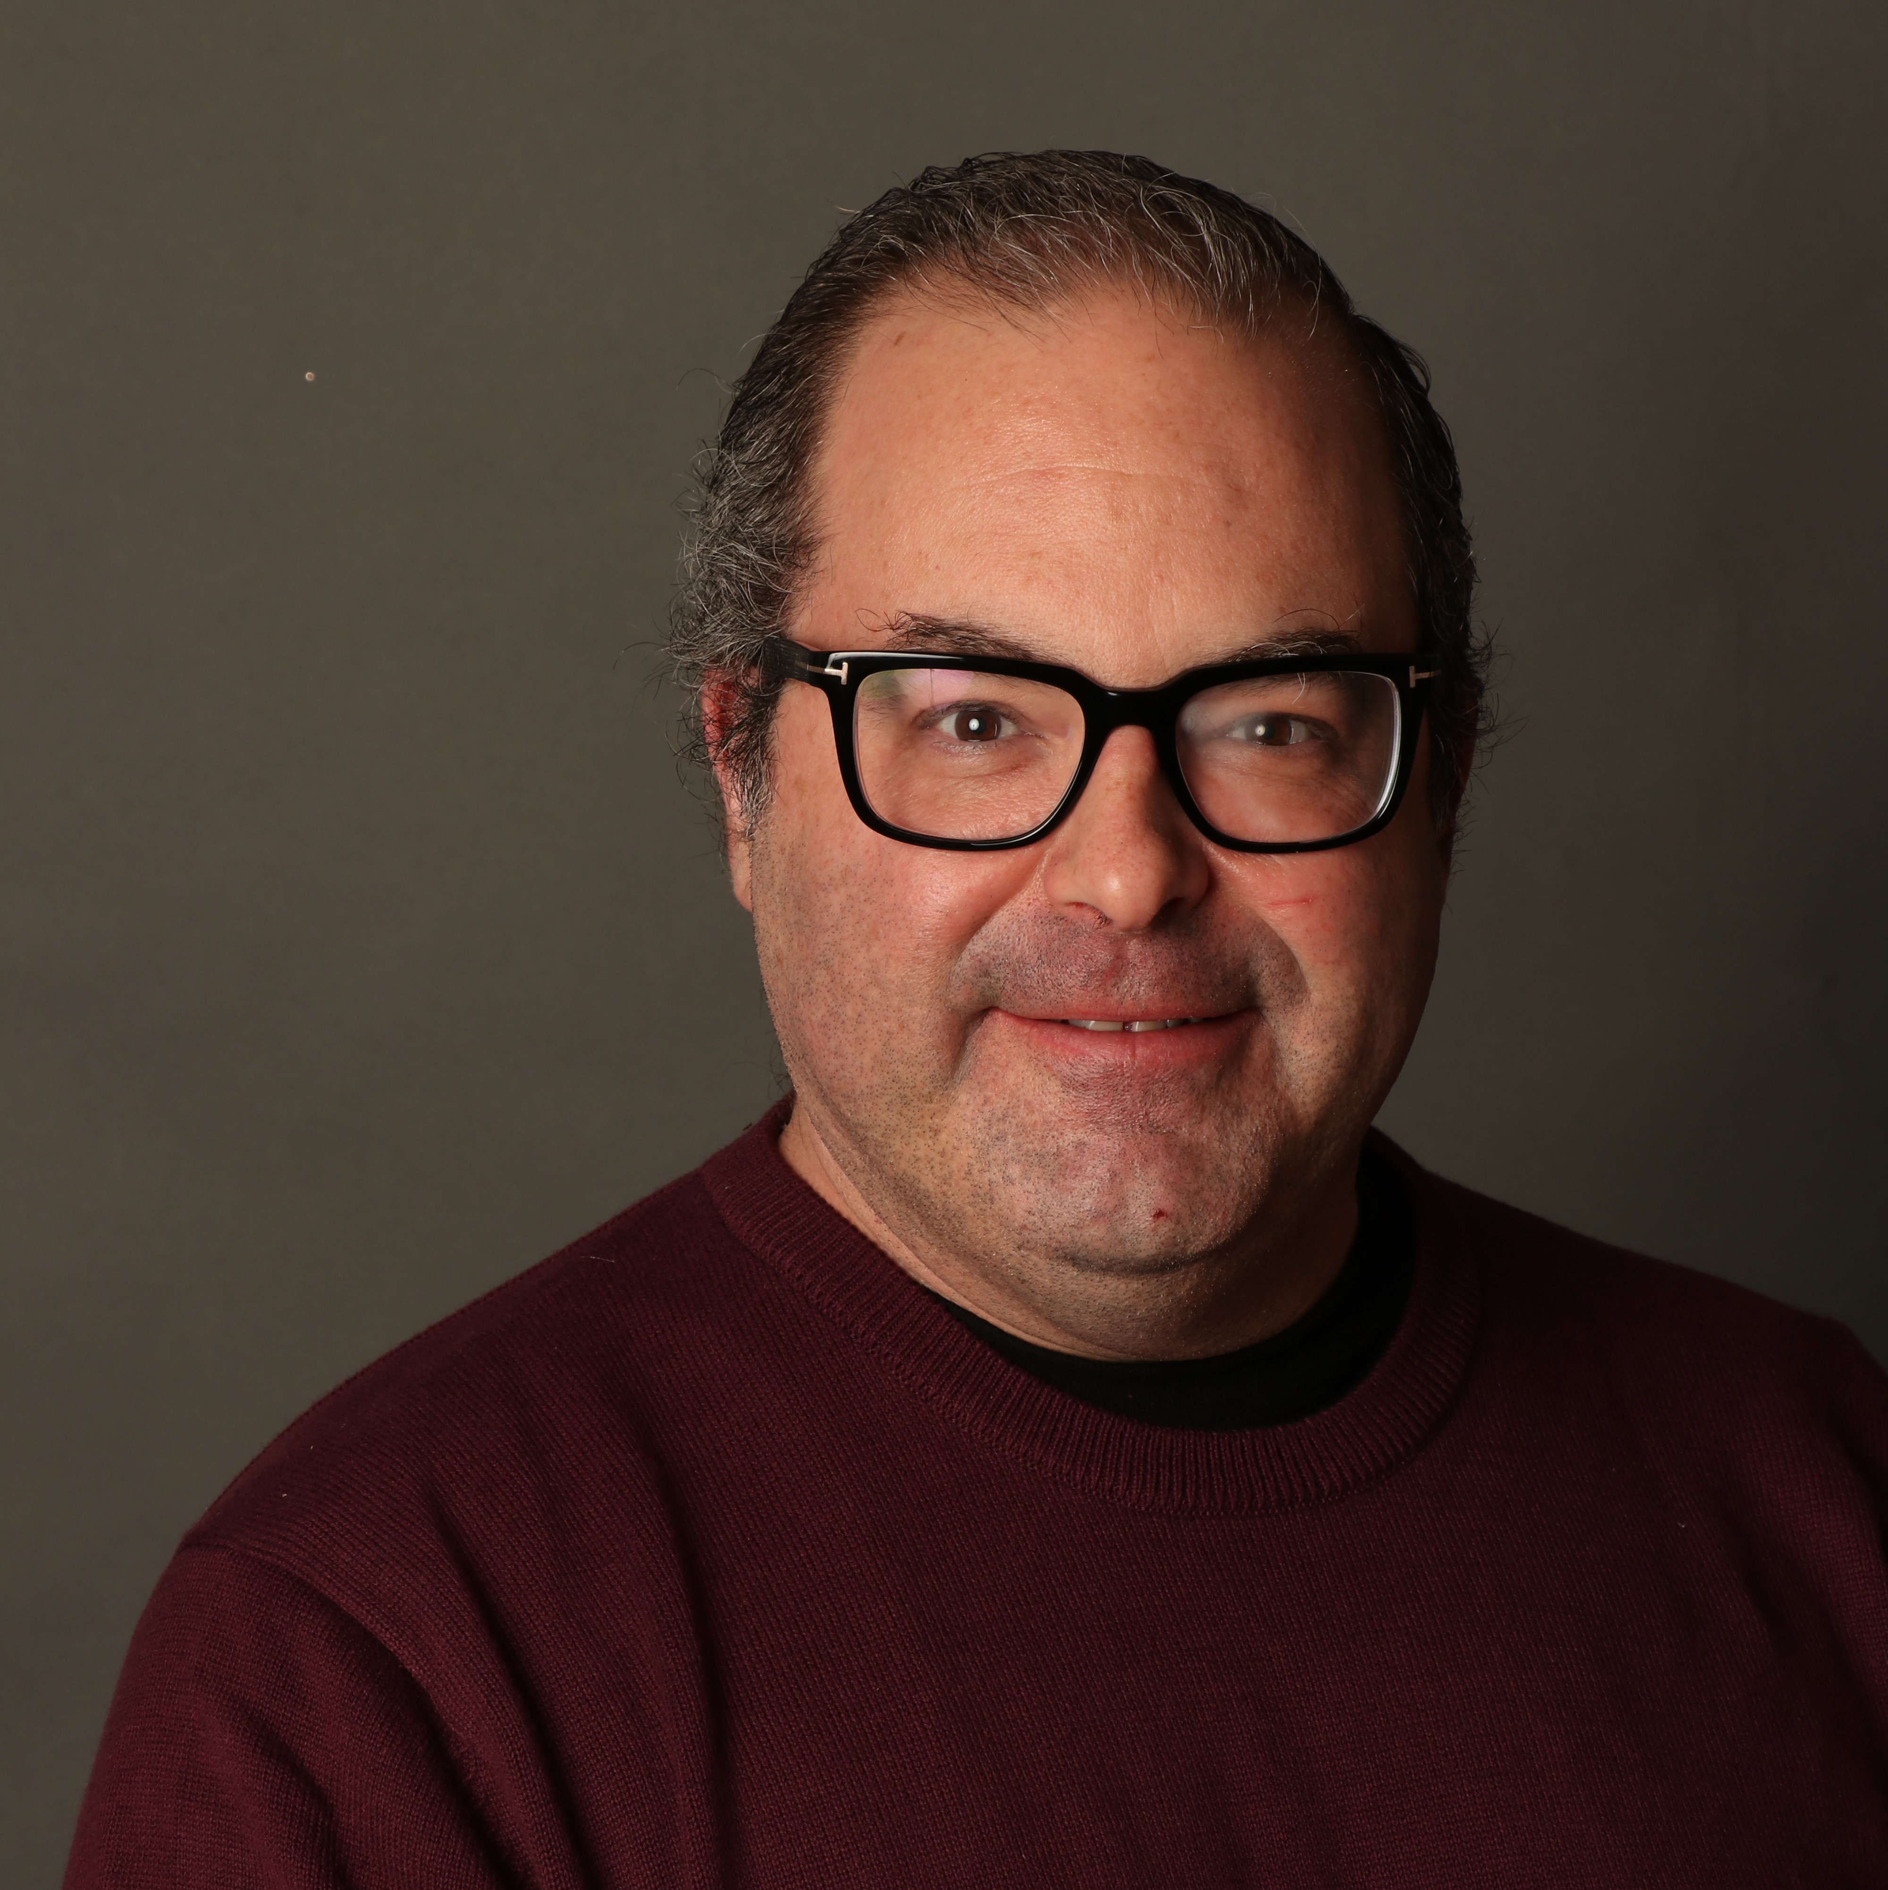


Mastering GitHub Copilot
Tim Warner
Principal Author, Pluralsight
tim-warner@pluralsight.com

Slide 2
asdf
Overview

Slide 3

Session Materials
timw.info/edo

Slide 4
The GitHub Copilot Ecosystem

Slide 5
How GitHub Copilot Works

Slide 6
Prompting GitHub Copilot For Success

Slide 7

Questions? Comments? Curiosities?

Slide 8
asdf
Thanks!
Email: tim-warner@pluralsight.com
LinkedIn: timw.info/li
Summary

